Slide 1


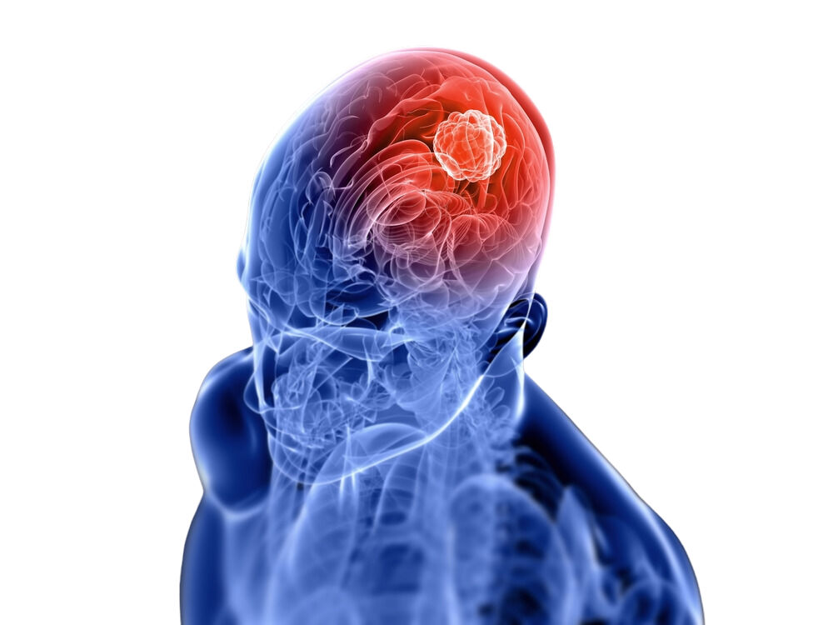
Explainable Ensemble Deep Learning Framework for Brain tumor Detection Using XAI

Slide 2



Introduction
About Brain Tumor
Brain tumors are abnormal growths in the brain that can disrupt normal neurological functions and pose serious health risks. Early and accurate detection is crucial for effective treatment and improving patient outcomes.
While deep learning techniques have transformed the field of medical imaging analysis, their application in brain tumor detection encounters challenges such as model transparency, reliability, and clinical interpretability.
This project proposes an ensemble-based approach integrated with explainable AI (XAI) techniques to overcome these challenges, enabling precise and interpretable brain tumor diagnosis.

Slide 3

Statistical Insights on Brain Tumor
Prevalence: As of 2019, approximately 1,065,294 individuals worldwide were living with brain cancer.
Incidence: In 2019, there were 347,992 new cases of brain and central nervous system (CNS) cancers globally, marking a 94.35% increase since 1990.
Mortality: Brain and CNS cancers resulted in 246,253 deaths worldwide in 2019, reflecting a 76.36% rise from 1990.
Undiagnosed Cases
A significant proportion of brain tumors remain undiagnosed, particularly in low-resource settings, due to limited access to advanced diagnostic tools and specialized healthcare services.
High-Risk Groups
Age: Brain tumors can occur at any age but are more prevalent in older adults.
Geographical Variations: Incidence rates vary globally, with higher rates observed in certain regions, potentially due to genetic and environmental factors.

Slide 4

Impact of AIML on Brain Tumor
Enhanced Diagnostic Precision
Early and Accurate Detection
Explainable AI for Clinical Trust
Scalable and Accessible Solutions

Slide 5



Methodology
1.Data Preparation
Data Collection
Preprocessing
2. Model Ensemble
Model Selection
Training
Ensemble Voting
3. Explainability
Grad-CAM
SHAP
4.Model Evaluation
Performance Metrics
Visualization

Slide 6
THANK YOU

